Slide 1


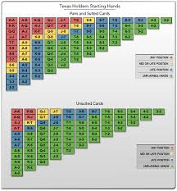
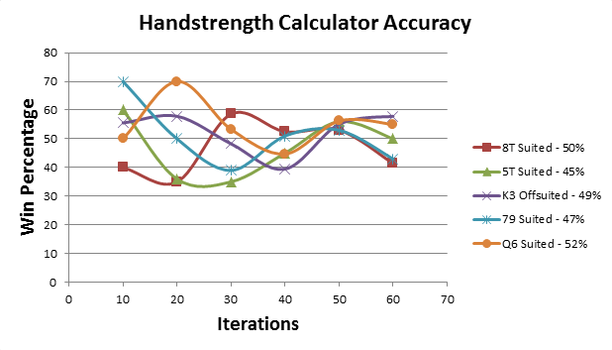
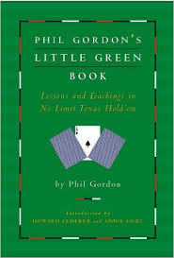

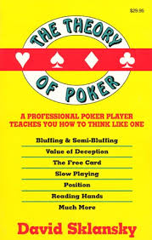
Texas Hold'em AI Program
Joseph Carrick
Computer Science
Berea College
aBOUt
Opponent observation
Heads-up game of Texas Hold'em with AI player
3 levels
Written in Python
Text and web interfaces
6 steps
1. At the end of every hand, record how opponent valued his hand.
Adjust his average hand value for each phase as the game goes on.
Repeat step 2 until estimated hand strength is some what accurate.
Guess a range of possible hands the opponent might have.
Narrow down range of hands as game goes on.
Look for uncharacteristic behavior to indicate bluffing or slow play.
Calculating hand strength
There are over 3 trillion possible outcomes in a heads-up game of Texas Hold'em
Playing all game outcomes would find the exact hand strength
Playing all game outcomes would take years on a standard laptop
How many game outcomes achieve a good approximation in only a few seconds?
Research
Phil Gordon's Little Green Book
Gus Hansen - Every Hand Revealed
David Slansky - The Theory of Poker
Pokerprobability.net
 | Heading | Heading | Heading
 | 122 | 233 | 345
 | 759 | 856 | 290
 | 228 | 134 | 238
 | 954 | 875 | 976
 | 324 | 325 | 301
 | 199 | 137 | 186
Personality programming
Poker math
Texas Hold’em strategy varies among professionals. Many are equally successful.
Strategy from poker books tends to reflect the writer’s style.
Some poker book tips are not programmable, but a lot are.
EX: Phil Gordon’s Little Green Book has tips for over 300 Hold’em scenarios. Most are unique to Phil’s style of play. Programming even half of these tips would produce an AI reasonable similar to how Phil Gordon plays.
Type a caption for the data content or pictures here.
Pot odds
Implied Odds
Notes:
To change this poster, replace our sample content with your own. Or, if you'd rather start from a clean slate, use the New Slide button on the Home tab to insert a new page, then enter your text and content in the empty placeholders. If you need more placeholders for titles, subtitles or body text, copy any of the existing placeholders, then drag the new one into place.

